Slide 1
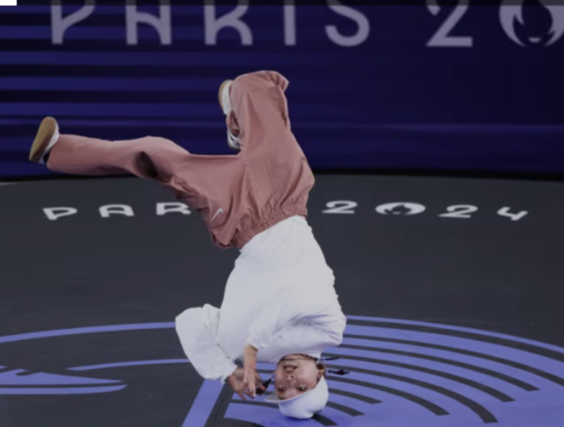
Uncertainty Working Group
Breaking Report Back
cbc.com

Slide 2
Who?
Nancy French
Mike Dietze
Ralph Dubayah
Denis Valle
Rodrigo Vargas
Tom Oda

Slide 3
Co-chair
No one.
Note Taker
Me.
Achievements
Uncertainty Framework (see next slides)
Plans
Test Framework with YOU

Slide 4
The burning question every CMS science team member wants to know:
How do I communicate
uncertainty in my products?
istock photos

Slide 5
Figure 2
Source of uncertainty
Prediction uncertainty
Predictors
Models
Observations
Structure
Initial
conditions
Model
structure
Measurement error
Spatial autocorrelation
Drivers and covariates
Model
parameters
Sampling
error
Temporal autocorrelation
Topic is not relevant for this type of
carbon prediction process
Uncertainty estimates include SOME but NOT ALL of relevant sources
Key
Topic is relevant but
NOT considered in uncertainty estimates
Uncertainty estimates include ALL relevant sources

Slide 6
Figure 6: Raczka et al. 2021
Source of uncertainty
Prediction Uncertainty
Predictors
Models
Observations
Structure
Initial
conditions
Model
structure
Measurement error
Spatial autocorrelation
Drivers and covariates
Model
parameters
Sampling
error
Temporal Autocorrelation

Slide 7
Plans
Science team
Prototype our framework with YOUR project
Please join Oct & Nov calls to place your project in our framework
Dissemination
Engage with DAACs to aid in using framework for products
Sunset UWG
Move focus to stakeholder/user engagement with products

